Slide 1
오후과제

Slide 2
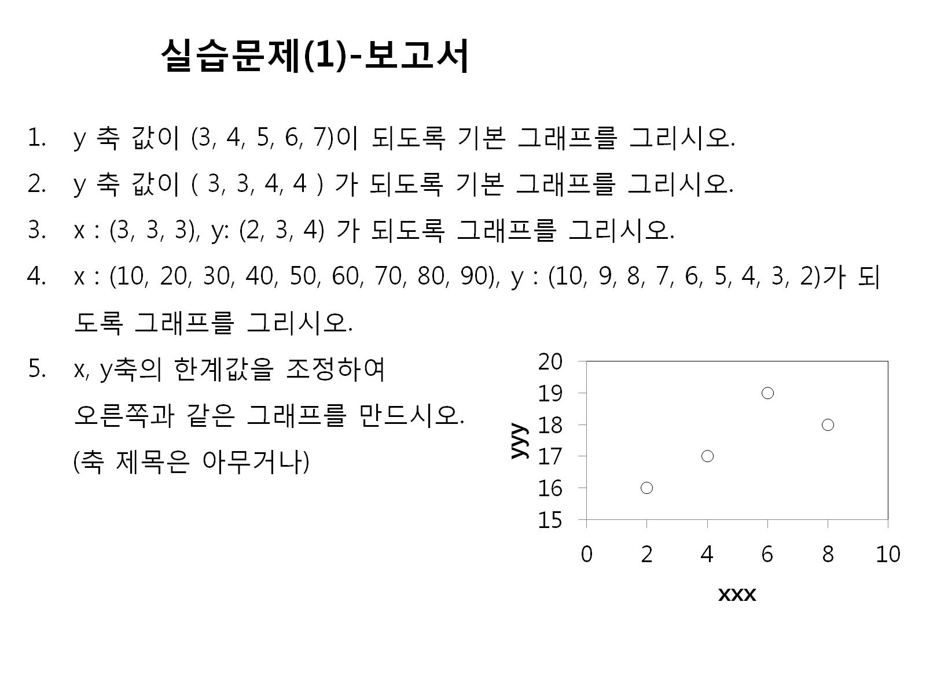

Slide 3
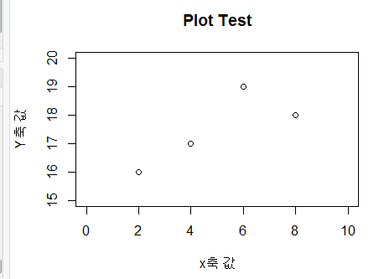
y<-c(3,4,5,6,7)
plot(y)
y<-c(2,2,2)
plot(y)
x<-c(3,3,3)
y<-2:4
plot(x,y)
x<-c(10,20,30,40,50,60,70,80,90)
y<-10:2
plot(x,y)
x<-c(2,4,6,8)
y<-c(16,17,19,18)
plot(x,y,xlim=c(0,10),ylim = c(15,20),
xlab="x축 값",ylab="Y축 값",
main="Plot Test")

Slide 4
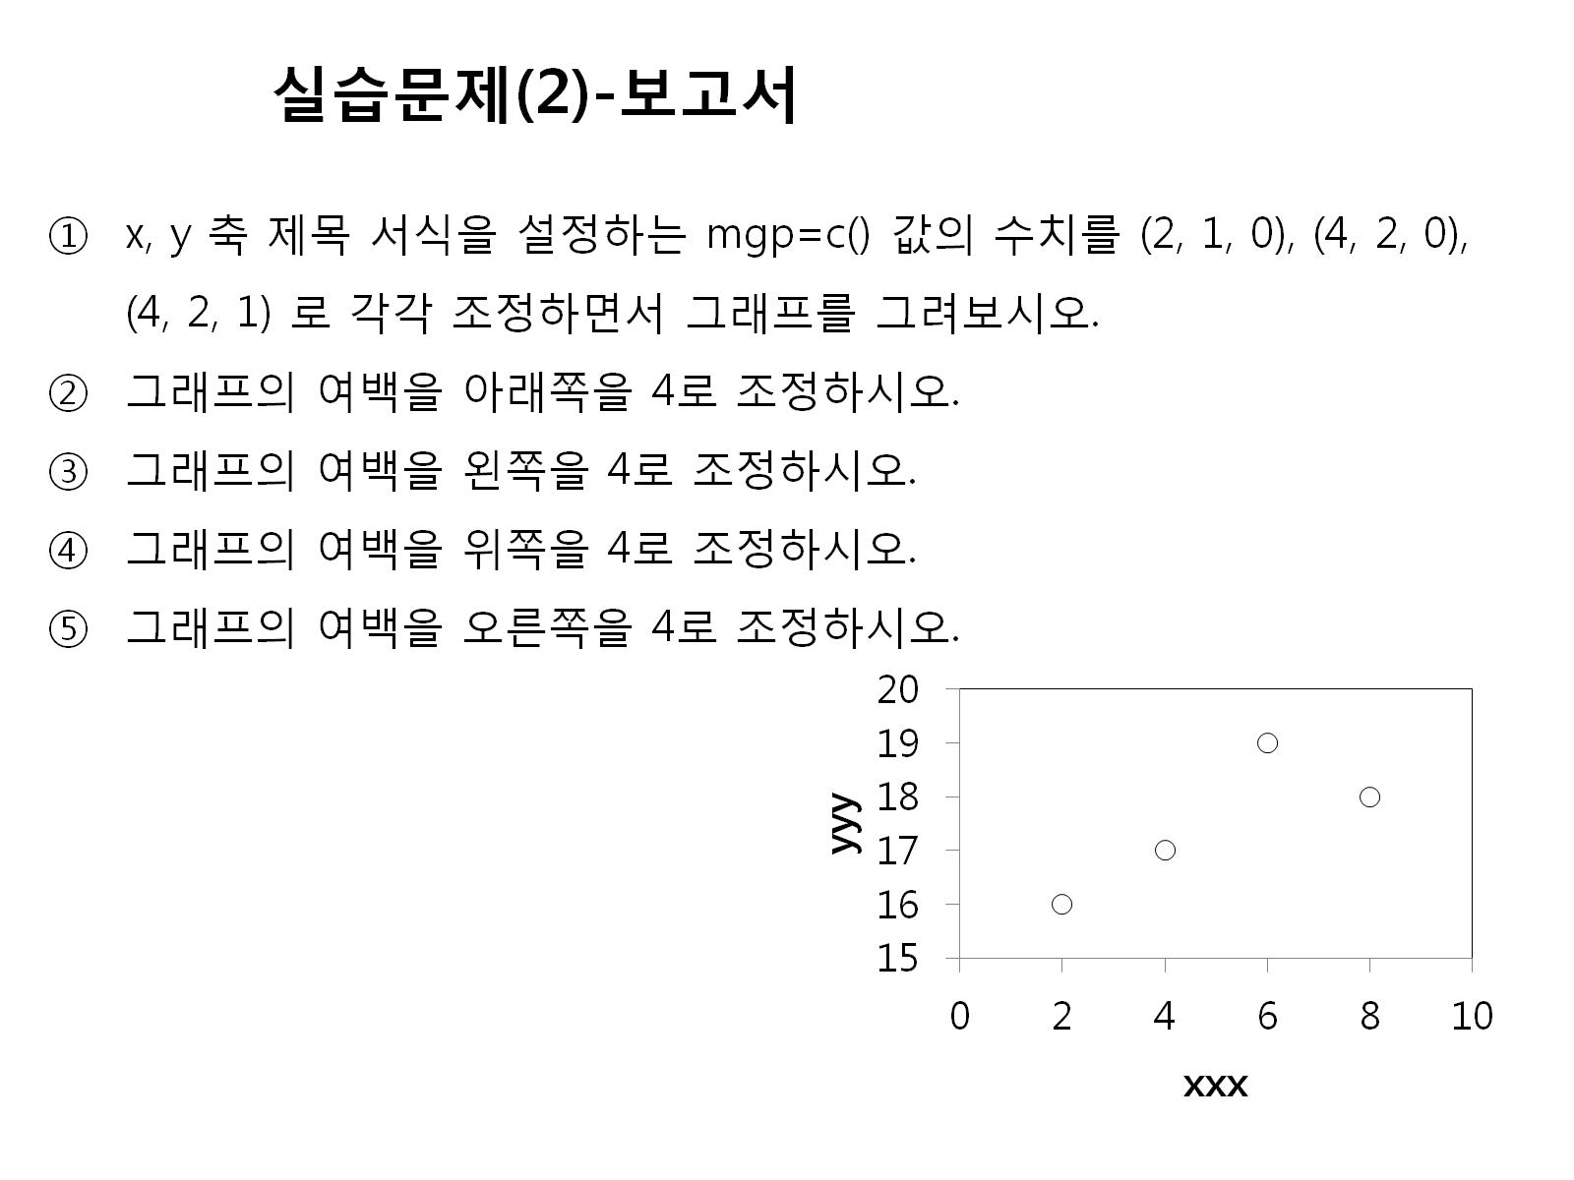

Slide 5
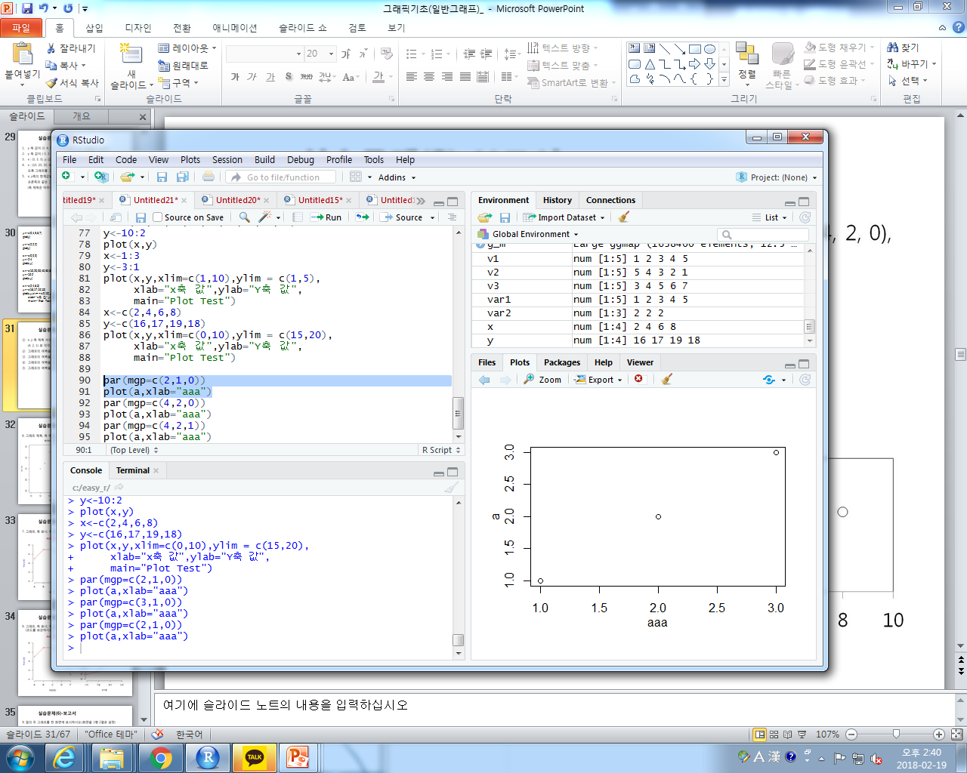
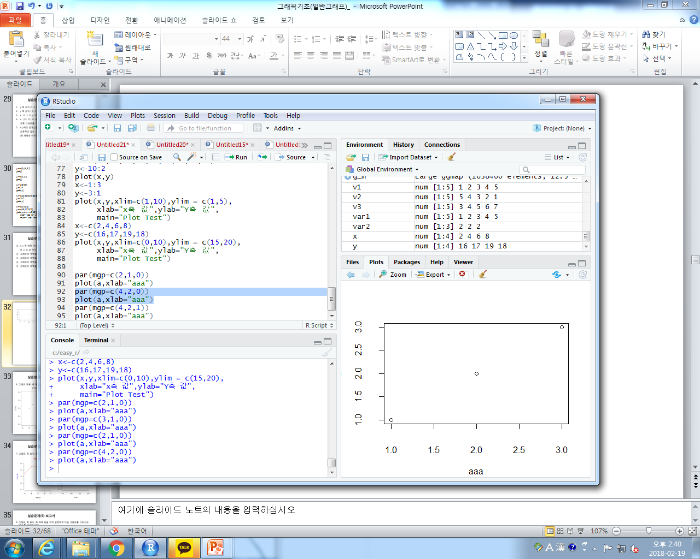
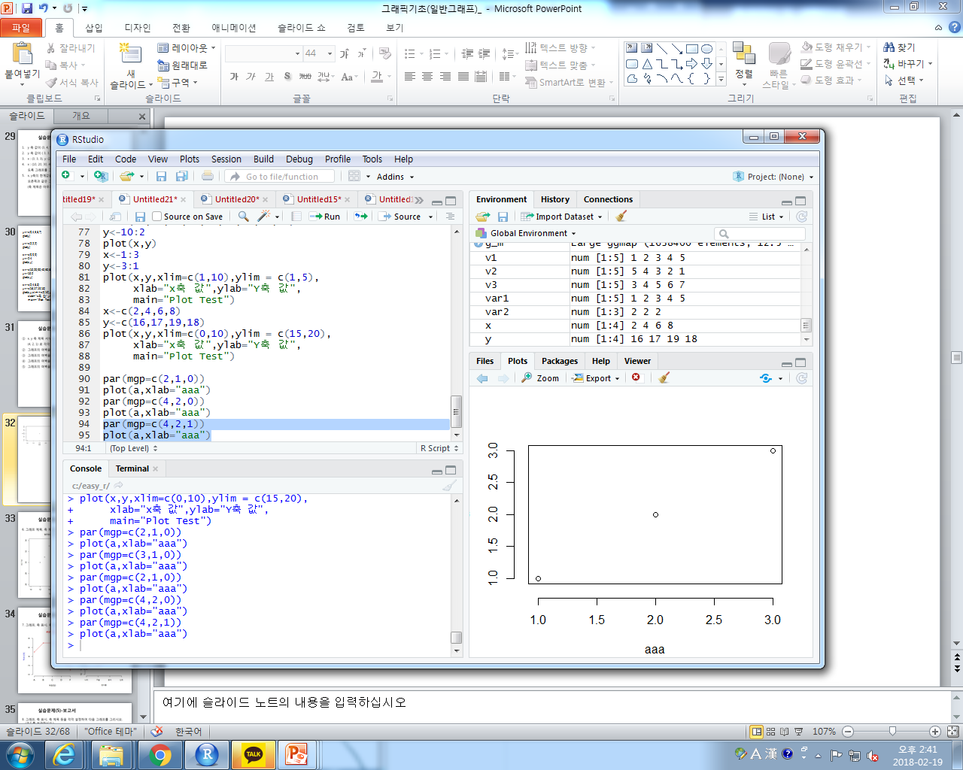
par(mgp=c(2,1,0))
plot(a,xlab="aaa")
par(mgp=c(4,2,0))
plot(a,xlab="aaa")
par(mgp=c(4,2,1))
plot(a,xlab="aaa")

Slide 6
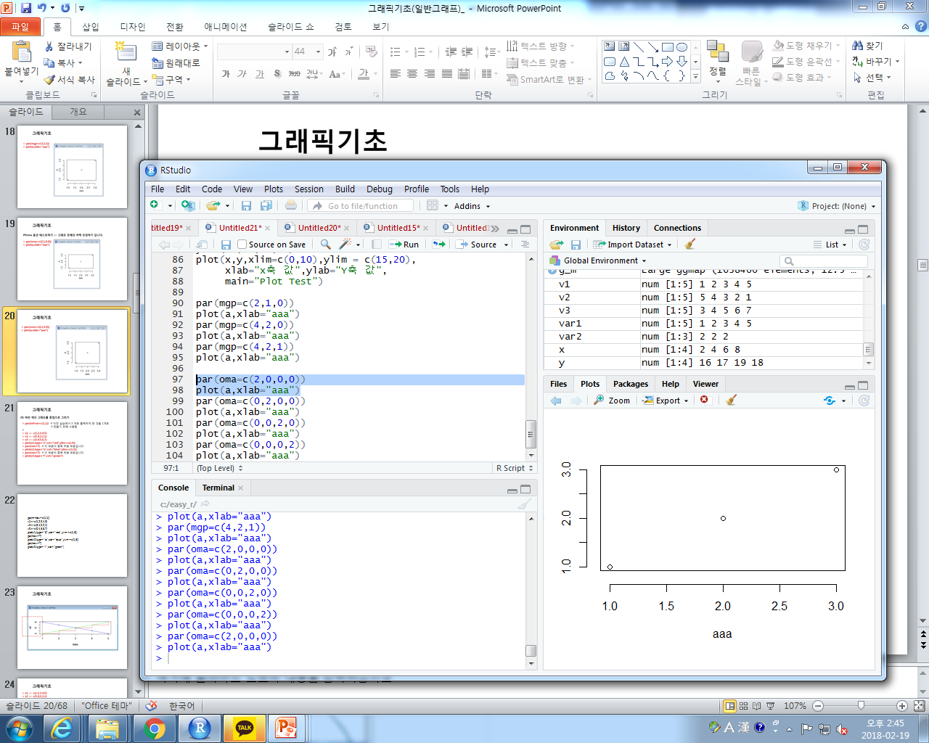
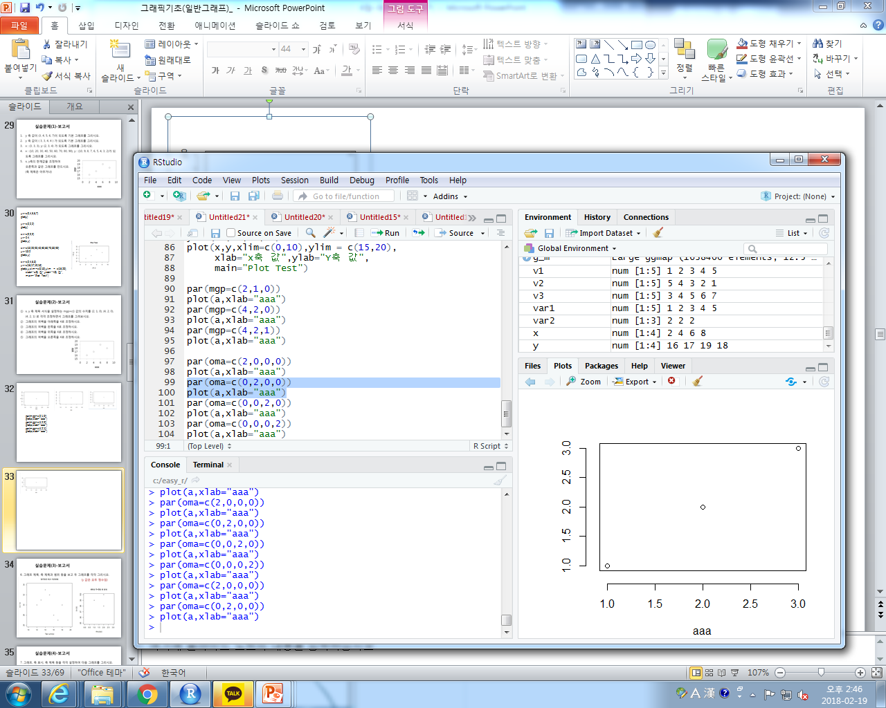
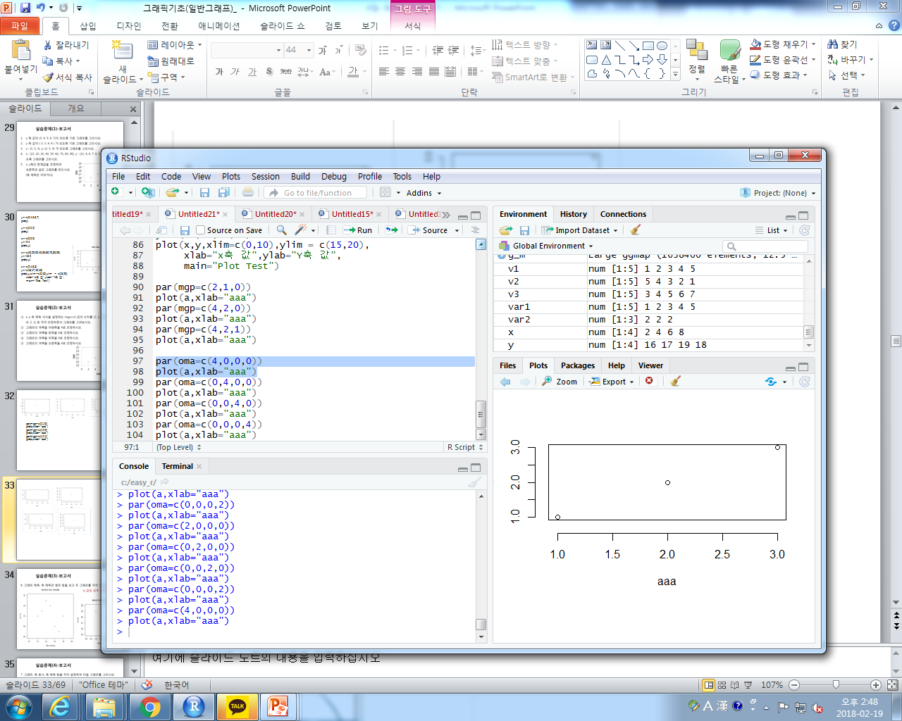
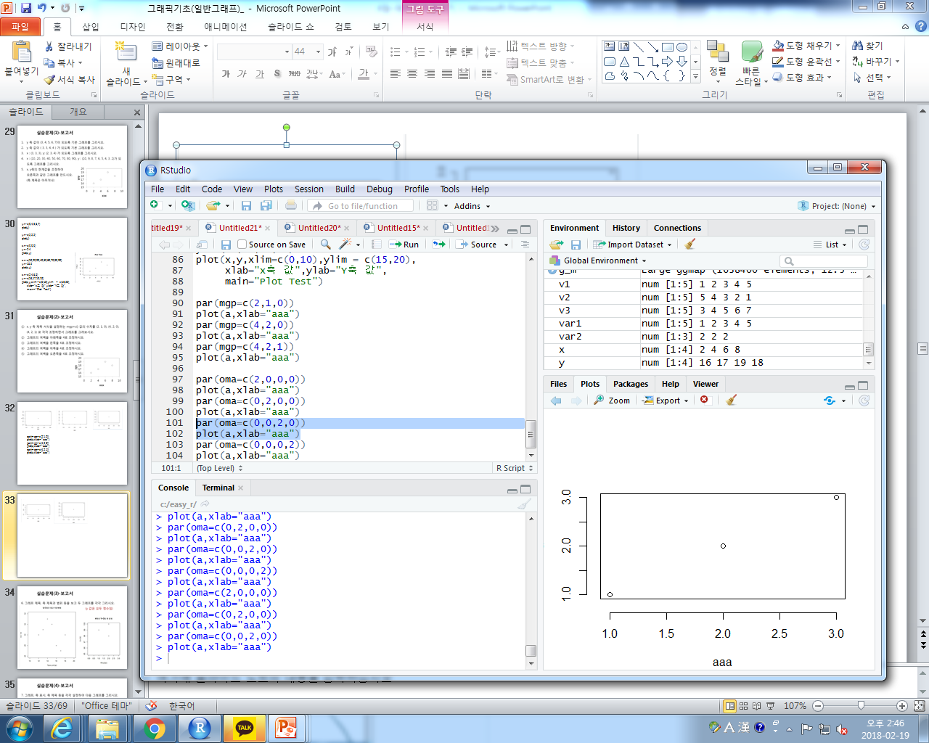
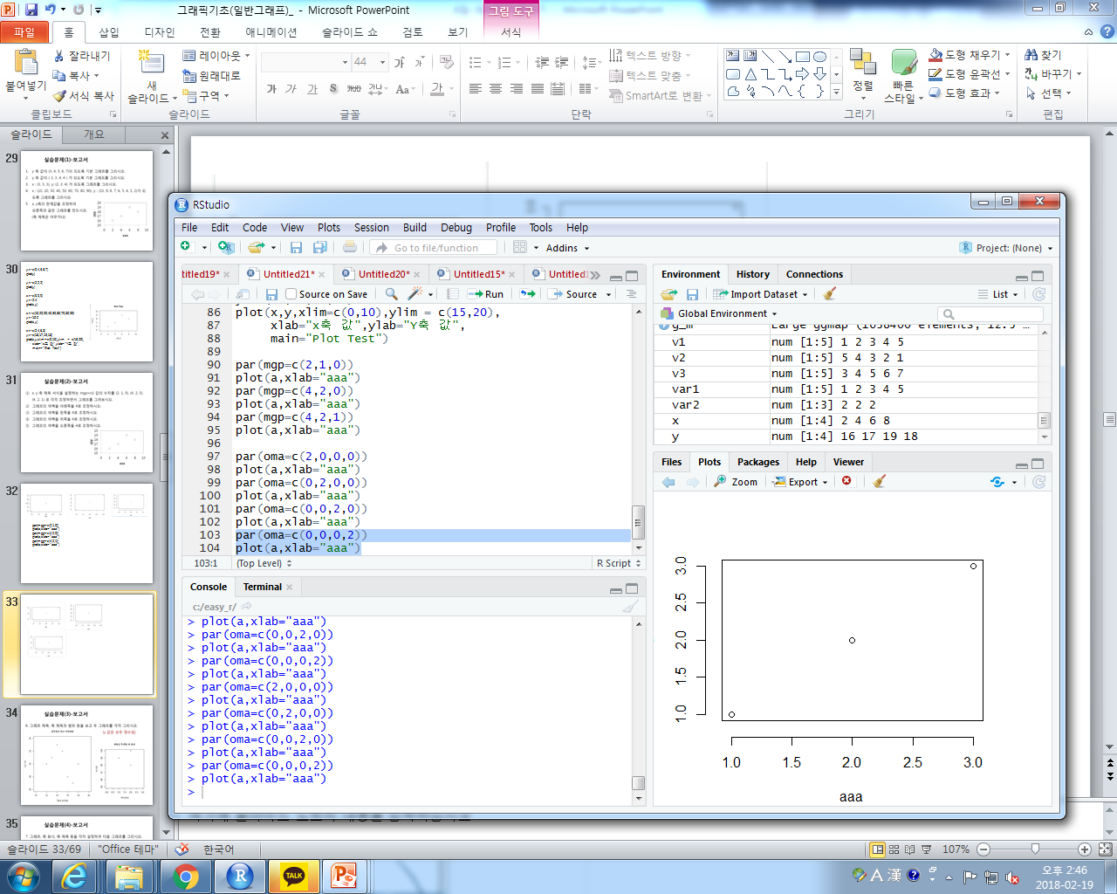
par(oma=c(4,0,0,0))
plot(a,xlab="aaa")
par(oma=c(0,4,0,0))
plot(a,xlab="aaa")
par(oma=c(0,0,4,0))
plot(a,xlab="aaa")
par(oma=c(0,0,0,4))
plot(a,xlab="aaa")

Slide 7
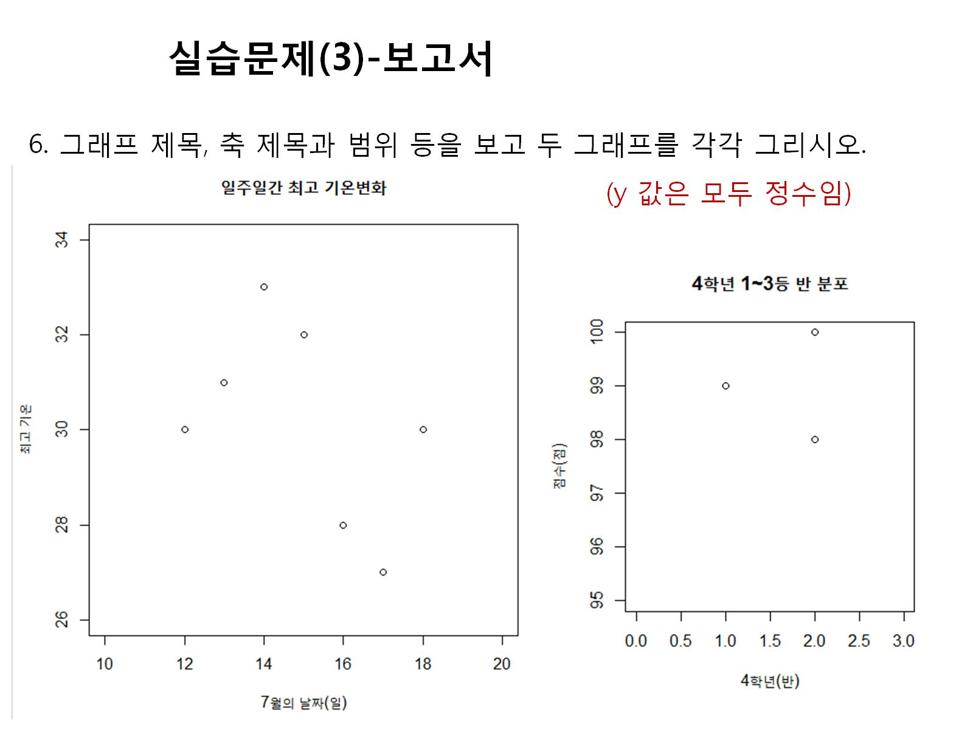

Slide 8
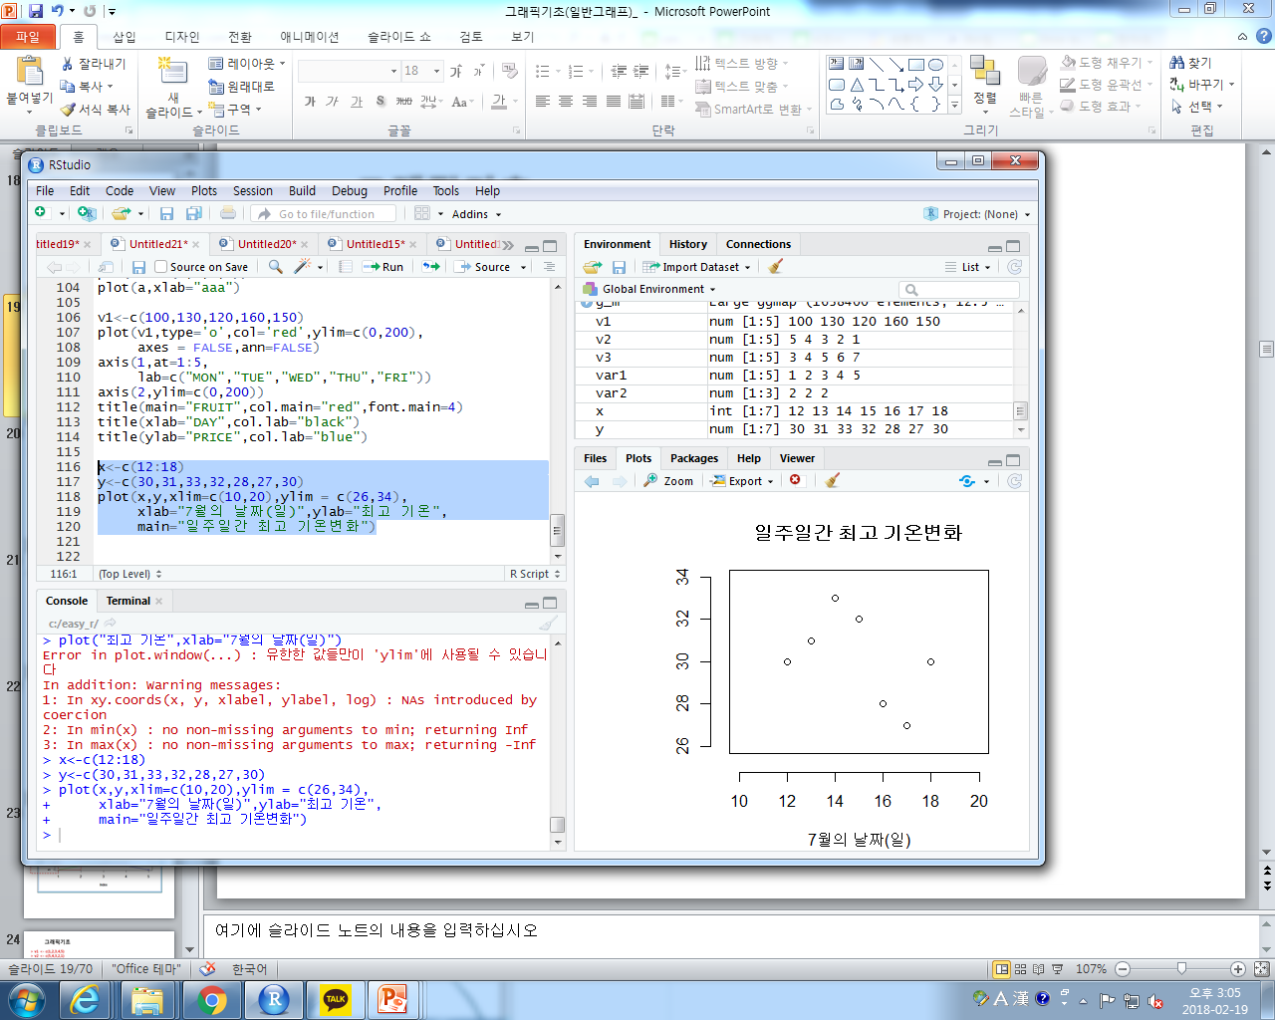
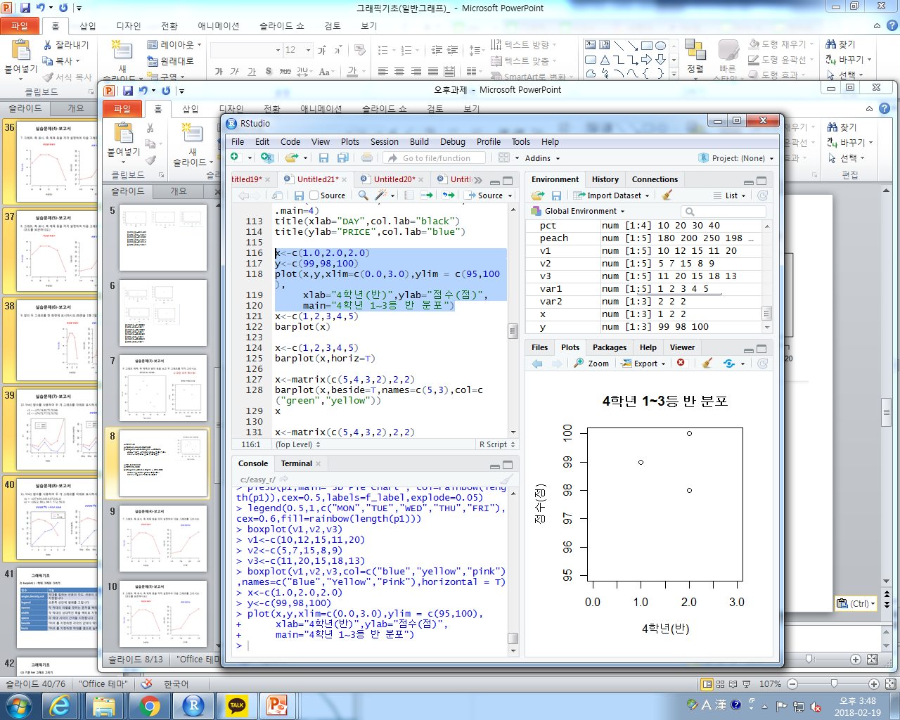
x<-c(12:18)
y<-c(30,31,33,32,28,27,30)
plot(x,y,xlim=c(10,20),ylim = c(26,34),
xlab="7월의 날짜(일)",ylab="최고 기온",
main="일주일간 최고 기온변화")
x<-c(1.0,2.0,2.0)
y<-c(99,98,100)
plot(x,y,xlim=c(0.0,3.0),ylim = c(95,100),
xlab="4학년(반)",ylab="점수(점)",
main="4학년 1~3등 반 분포")

Slide 9
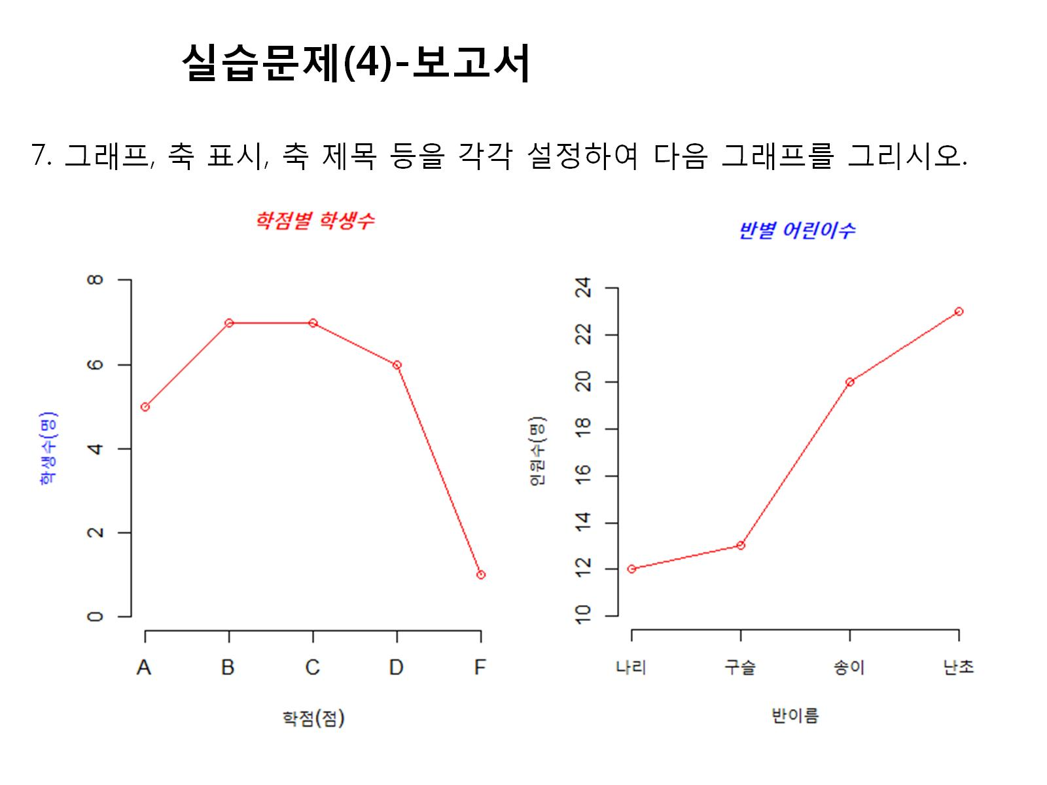

Slide 10
v1<-c(5,7,7,6,1)
plot(v1,type='o',col='red',ylim=c(0,8),axes = FALSE,ann=FALSE)
axis(1,at=1:5,
lab=c("A","B","C","D","F")
axis(2,ylim=c(0,200))
title(main="FRUIT",col.main="red",font.main=4)
title(xlab="DAY",col.lab="black")
title(ylab="PRICE",col.lab="blue")

Slide 11
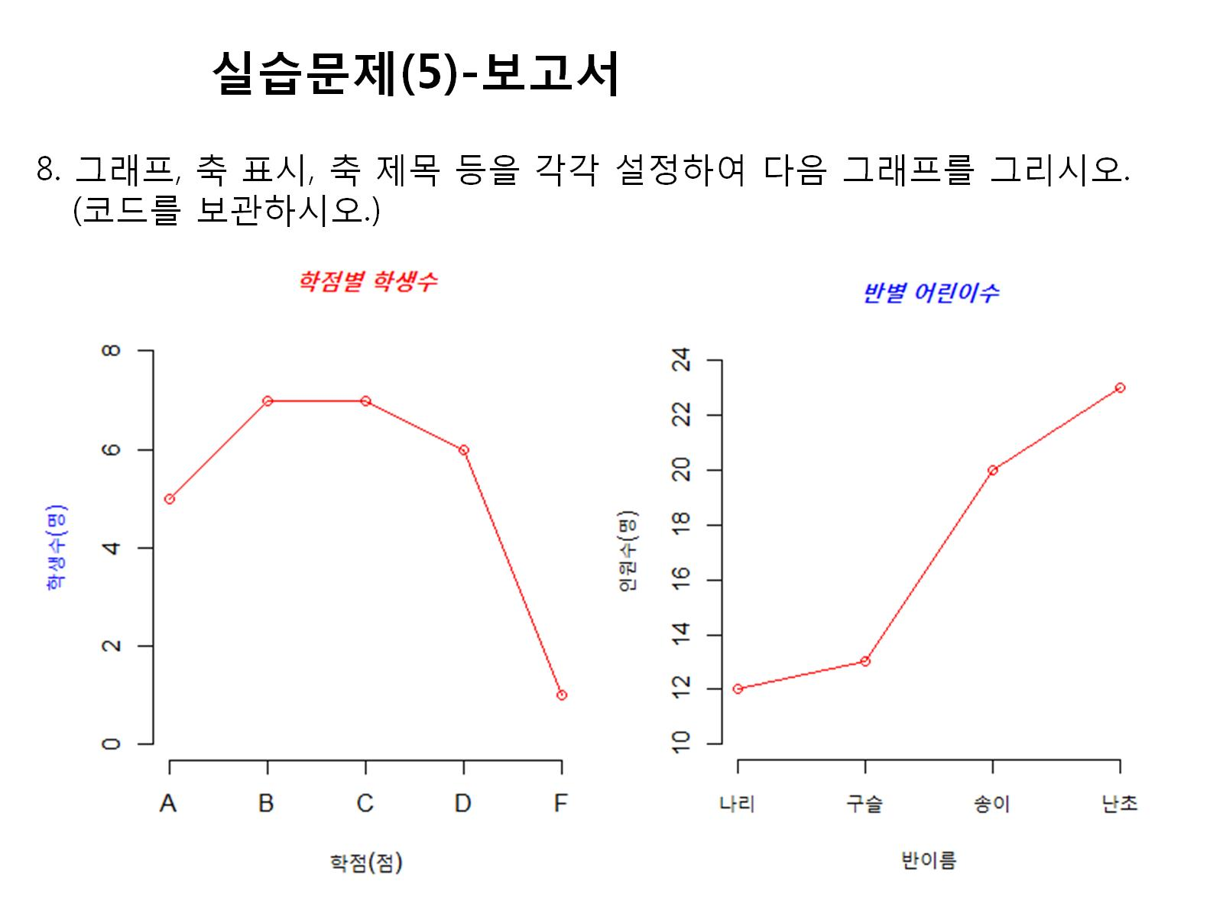

Slide 12
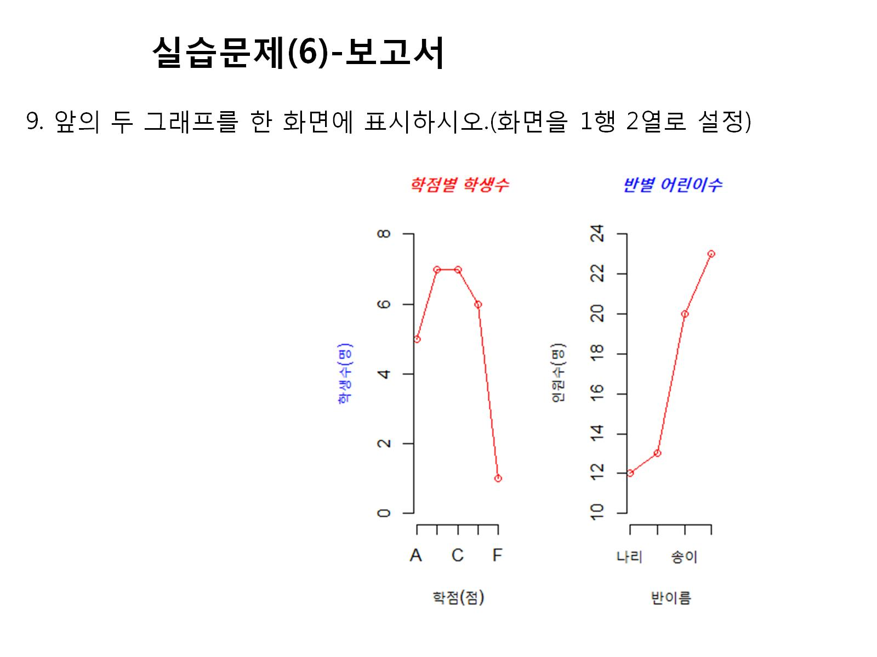

Slide 13
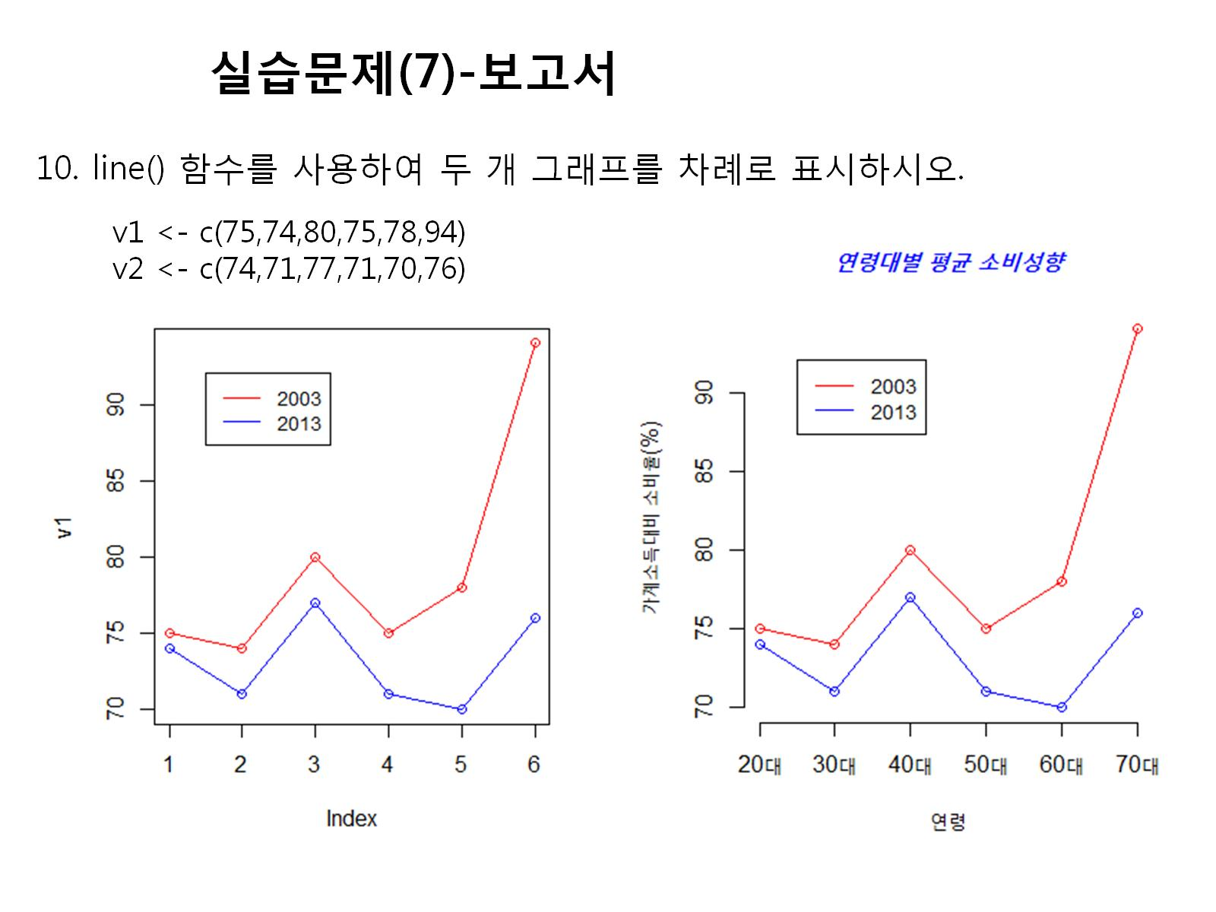

Slide 14
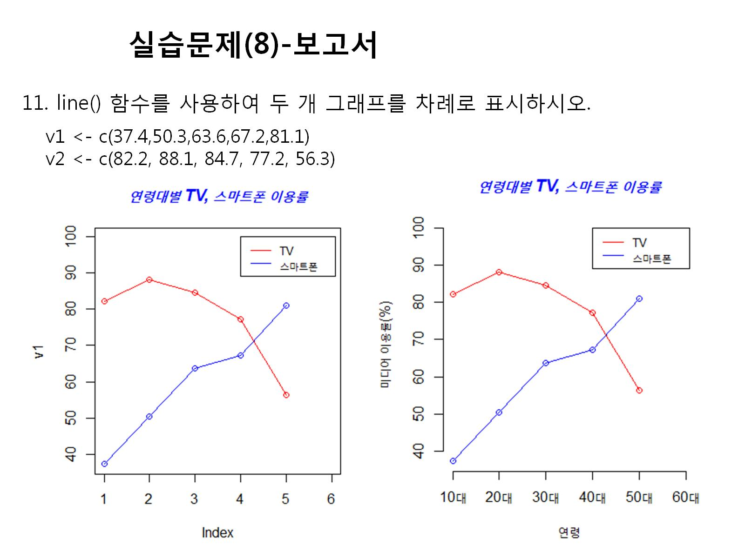

Slide 15
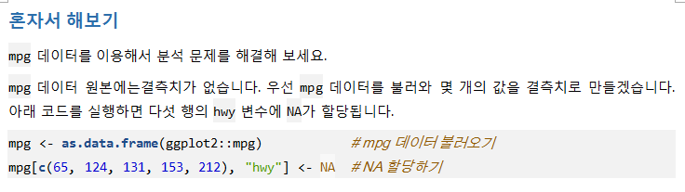
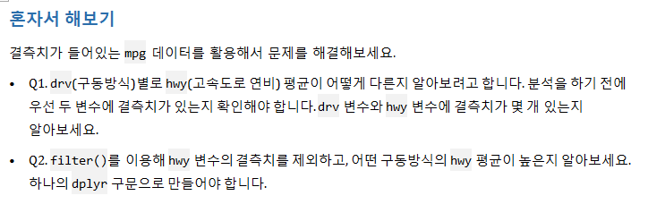
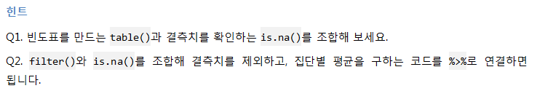

Slide 16
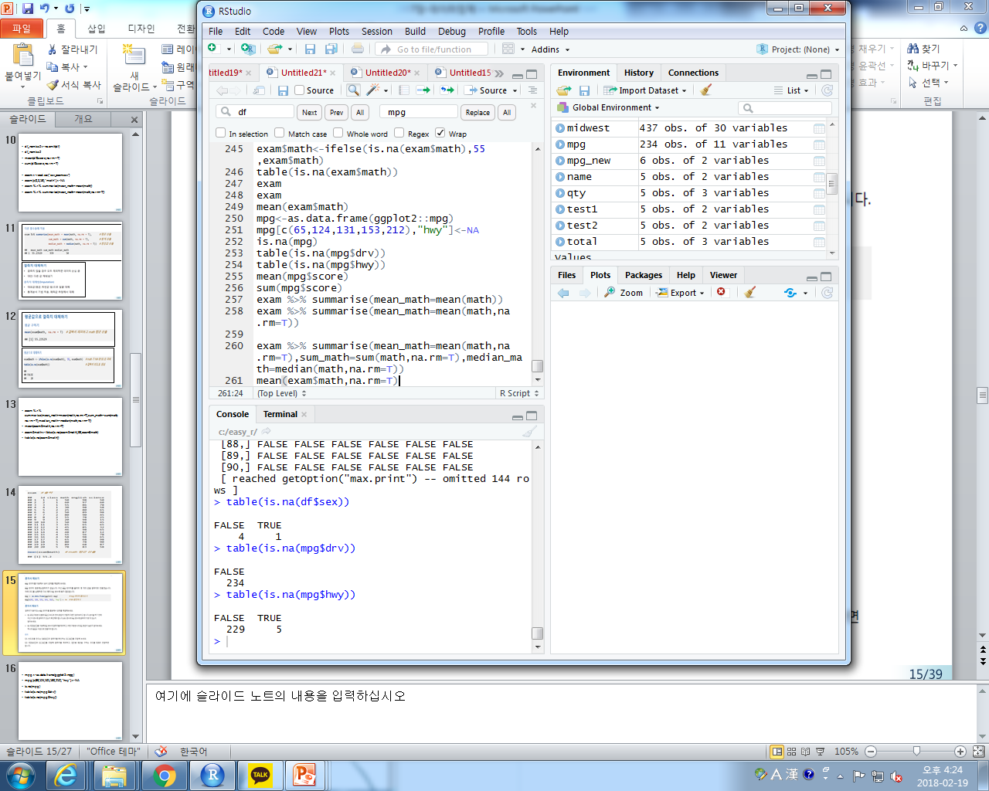
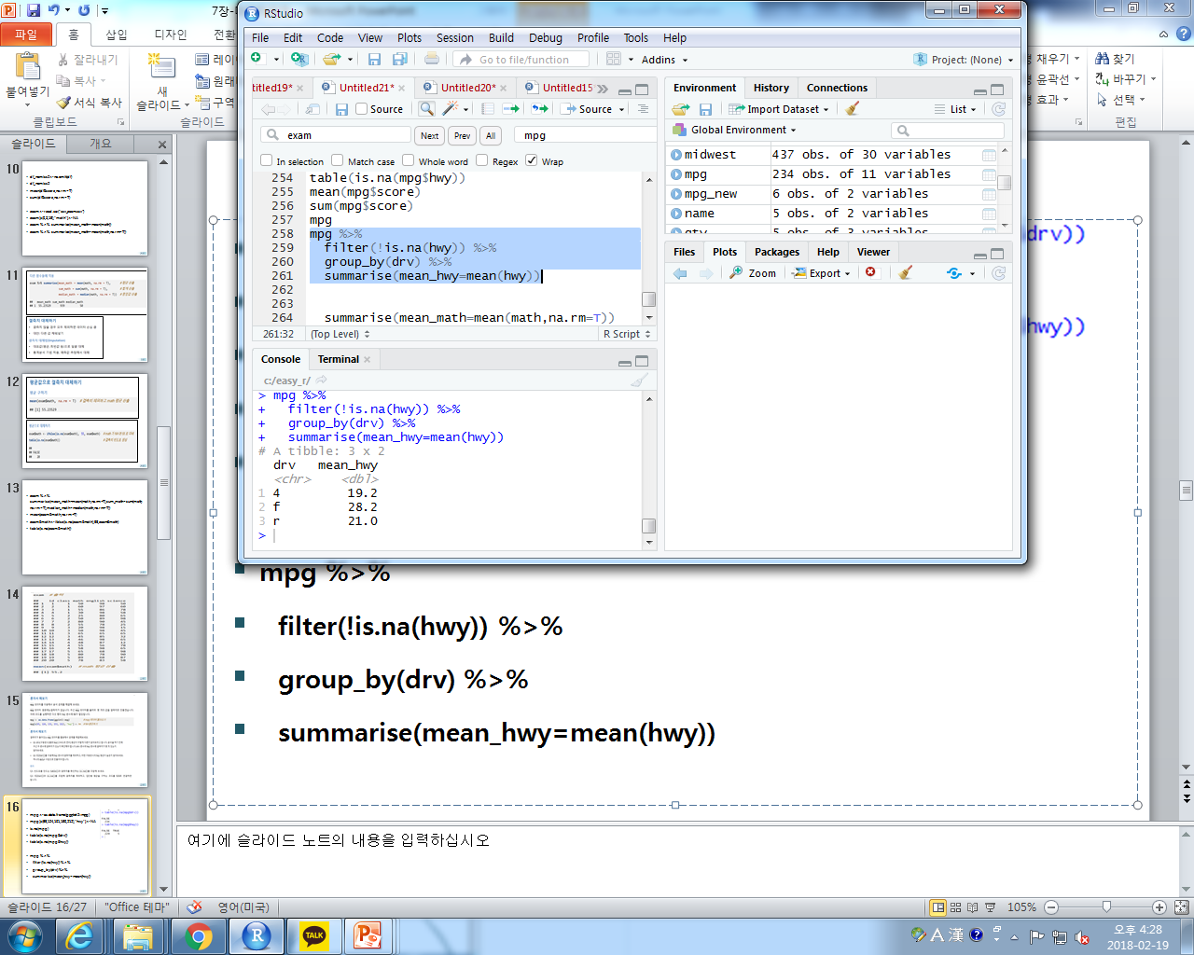
mpg<-as.data.frame(ggplot2::mpg)
mpg[c(65,124,131,153,212),"hwy"]<-NA
is.na(mpg)
table(is.na(mpg$drv))
table(is.na(mpg$hwy))
mpg %>%
filter(!is.na(hwy)) %>%
group_by(drv) %>%
summarise(mean_hwy=mean(hwy))

Slide 17
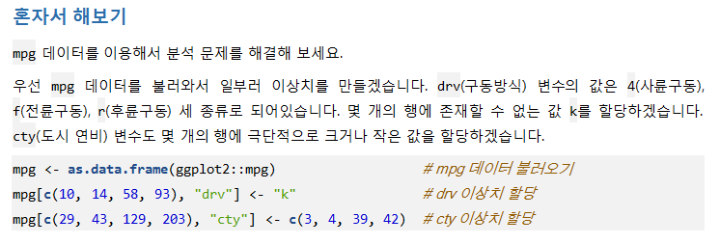
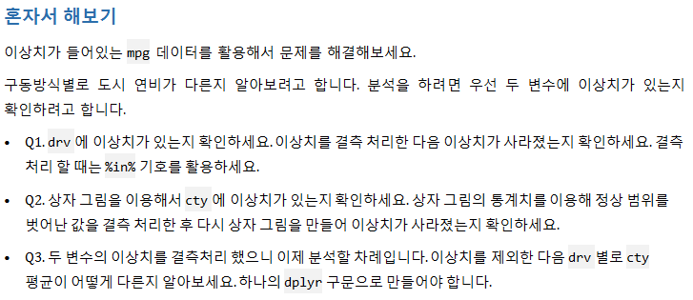

Slide 18
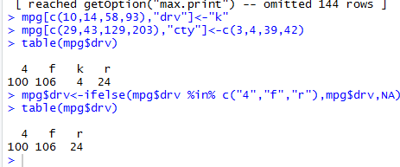
1번
mpg[c(10,14,58,93),"drv"]<-"k"
mpg[c(29,43,129,203),"cty"]<-c(3,4,39,42)
table(mpg$drv)
mpg$drv<-ifelse(mpg$drv %in% c("4","f","r"),mpg$drv,NA)
table(mpg$drv)

Slide 19
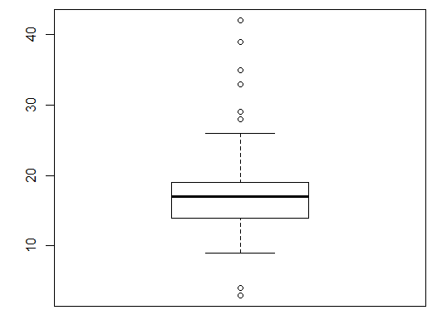
2번
boxplot(mpg$cty)$stats

Slide 20
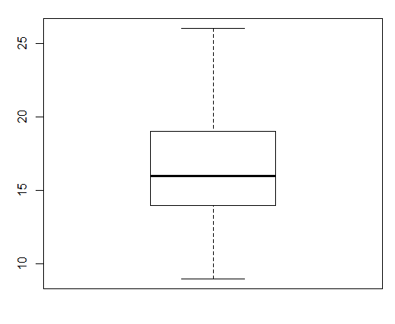
3번
mpg$cty<-ifelse(mpg$cty<9|mpg$cty>26, NA,mpg$cty)
boxplot(mpg$cty)

